Slide 1
Federal Reserve Bank Data
Asim Aslam
Colorado State University Global
Course Code: MIS445
Professor Ahmad
1/25/26

Slide 2
Definition of Gross Domestic Product (GDP)
Measures the value of goods and services produced
Reflects overall economic performance
Real GDP is adjusted for inflation
According to the Federal Reserve Bank of St. Louis, gross domestic product represents the value of goods and services produced by the nation’s economy after accounting for production inputs. GDP is also the sum of consumption, investment, government spending, and net exports. Real GDP adjusts for inflation, allowing for accurate comparisons across time.

Slide 3
Dataset Description
Source: Federal Reserve Bank of St. Louis (FRED)
Time-series dataset
Quarterly observations
Variable: GDP growth rate (%)
The dataset used in this analysis was obtained from the Federal Reserve Bank of St. Louis FRED database. It is a time-series dataset containing quarterly observations of real U.S. GDP growth rates. Each observation represents the percentage change in GDP for a given period.

Slide 4
Summary Statistics of Real GDP Growth
Mean GDP growth rate: ~3.2%
Median GDP growth rate: ~3.1%
Minimum growth rate: ~-10%
Maximum growth rate: ~16.7%
The summary statistics provide insight into the overall behavior of GDP growth over time. The mean and median indicate that GDP typically grows at around three percent per quarter. However, the wide range between the minimum and maximum values highlights periods of significant economic contraction and expansion, showing that GDP growth can be highly volatile.

Slide 5
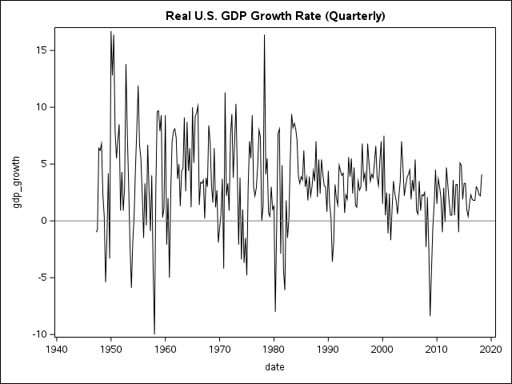
Real U.S. GDP Growth Over Time
This time-series line graph displays real U.S. GDP growth over time. A line chart is appropriate because it clearly shows trends, cycles, and fluctuations across sequential periods. The reference line at zero helps identify economic contractions when growth falls below zero, such as during recessions.
Caption: Quarterly GDP Growth Rate (%)

Slide 6
Conclusion and Key Insights
GDP growth varies significantly over time Periods of recession show negative growth Long-term trend shows overall economic expansion Time-series analysis is effective for economic data
In conclusion, the analysis shows that real U.S. GDP growth experiences both expansion and contraction across different periods. While long-term trends indicate economic growth, short-term volatility reflects business cycles and recessions. Using SAS Studio for exploratory analysis and visualization provides a clear understanding of these economic patterns.

